Slide 1
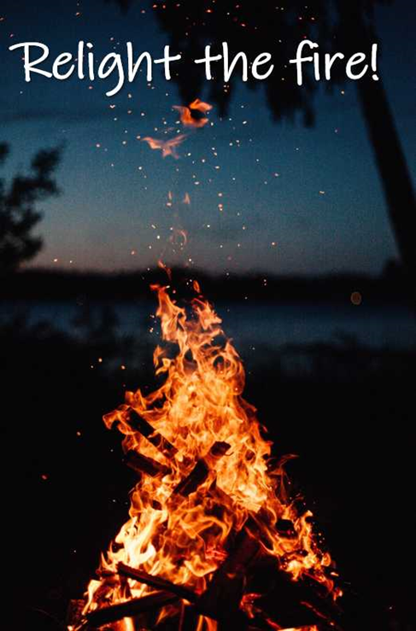
How to RE-LIGHT THE FIRE in YOU
and your business! (back into Momentum)
Ok firstly...You’re probably wondering how the momentum fizzled out in the first place right?
Well, the answer is pretty simple. 3 things!
1- Lack of PRODUCTIVE activity... Lead Generation, and Enrolling people!
2- Spending too much time on the wrong activity.... typically trying to do everything for everyone, managing the team, trying to motivate everyone, creating training after training, wanting it for others more than they want it for themselves! This is NOT sustainable... it also NOT Network Marketing!
3 - Everyone goes through it... but its not about what happens to us... it's about what we do about it... and what we do about it is: YOU DECIDE TO GROW AS A LEADER and lift your business into it's next PHASE! What's that song, When the going gets tuff.. the tuff get going!
When we are in CORRECT activity mode, even if it's just a little bit every day, this is less likely to happen!
Here are some good tips that will make it easier to increase the momentum and get things moving in the right direction again!

Slide 2
1- RELAUNCH YOUR BUSINESS!!
Yep, it doesn't matter if you've been in the business for 5 years, 10 years, or 5 minutes. You can launch your business, and you can come up with a really exciting business launch plan!
It can START with a ENERGETIC Social Media Post... similar to when you first started... just tweaked a little... let me give you an example:
***BUSINESS UPDATE**** well it's been 4.5 years since I MADE ONE OF THE BEST DECISIONS OF MY LIFE!! etc etc... ( make reference to health/improvements - helping people with their own health challenges... how you have helped or helping people to take control of their futures in these uncertain times... etc ... if you would like to find out more etc etc.... SO YES A RELAUNCH...
Remember why we ask NEW people to LAUNCH... it's not just about creating awareness, it's about creating a 1st POSITIVE STEP, FOCUS then followed by a series of INTENTIONAL STEPS! So it is PAVING the way for CHANGE! It is COMMITING YOU TO NOW FOLLOW THROUGH!!
COMMIT to a 90 day plan! So the work that is to follow... personally and team involvement/support around this RE-LAUNCH you must KEEP THE ENERGY and FOCUS GOING for 90 days...
WHY 90 days???? Because it takes time for the activities to compound to deliver the RESULTS you are looking for! This is not to try and get a quick win... it's to MOVE YOU and your TEAM into MOMENTUM!! So, decide and commit, to doing a business relaunch,

Slide 3
2 - GET OTHERS INVOLVED! Get on a ZOOM call WITH YOUR TEAM!
You’ll want to let your team know the plan...what people get in on they get UP ON! Let them know what you're doing, what you're going to be doing as far as the launch goes, and inject that excitement throughout your team...
Remember, it starts with you as the leader to create that excitement, energy, and focus to INITIATE this exciting new plan and START doing the ACTIVITIES!! This is a LEAD from EXAMPLE PLAN! - Your team is going to be watching what you're doing, versus just listening to what you tell them to do!
A TIP: When you're doing this business launch and then you get on the zoom call with your team, most people appreciate accountability it helps to keep us on track... so you could do a video call once a week with those who want to be part of it. This help keep the momentum going and energy high and you will be amazed at how more activity gets done! Sharing what has worked well that week!
3 - Get an Accountability Partner
Get an accountability partner for the next 30, or 60, or 90 days. It’s so much better when you’re running with a partner towards a similar goal. You get to motivate each other, check-in with each other, and just remember…a lot of the time, it's easier to give up and disappoint ourselves than somebody else! So it helps EVERYONE. So consider bringing an accountability partner into the mix!

Slide 4
PLEASE NOTE!! You want to make whatever you're doing fun, and if there's any way that you can do this... maybe throw in some small prizes, recognise achievements, be a bit creative, this will really help with motivation and how people feel about what they are doing and having some fun again... remember this is for 90 days.... so if it's ALL work and NO FUN and NO accountability it will lose energy!
So if you do it right...you're going to see some pretty amazing magic happen inside of your team and in your momentum!
Yes a RELAUNCH takes a DECISION... a COMMITMENT... it requires NEW ENERGY! It requires leading by EXAMPLE! It only take a few people who get committed to their GOALS DREAMS and ASPIRATIONS to come onboard with you and YOU CAN CHANGE EVERYTHING AROUND!
The opposite to doing this is if nothing changes nothing changes! I love the analogy of trying to chop down a tree with a blunt axe! It takes longer, it's more arduous, and very frustrating! With a SHARPENED AXE it makes light work of things!!
People are looking for guidance and leadership and want to be part of a success plan!
Hope this helps someone... ANYONE can do what I have shared with you... it's simply a case of FOCUSING on the SOLUTION and what you WANT FROM doTERRA and not focusing on the problem and losing sight of your DREAMS!
#relightmyfire

